Slide 1
Exploring Data with Graphs

Slide 2
Aims
How to present data clearly
Introduce ggplot2
Graphs
Scatterplots
Histograms
Boxplots
Error bar charts

Slide 3
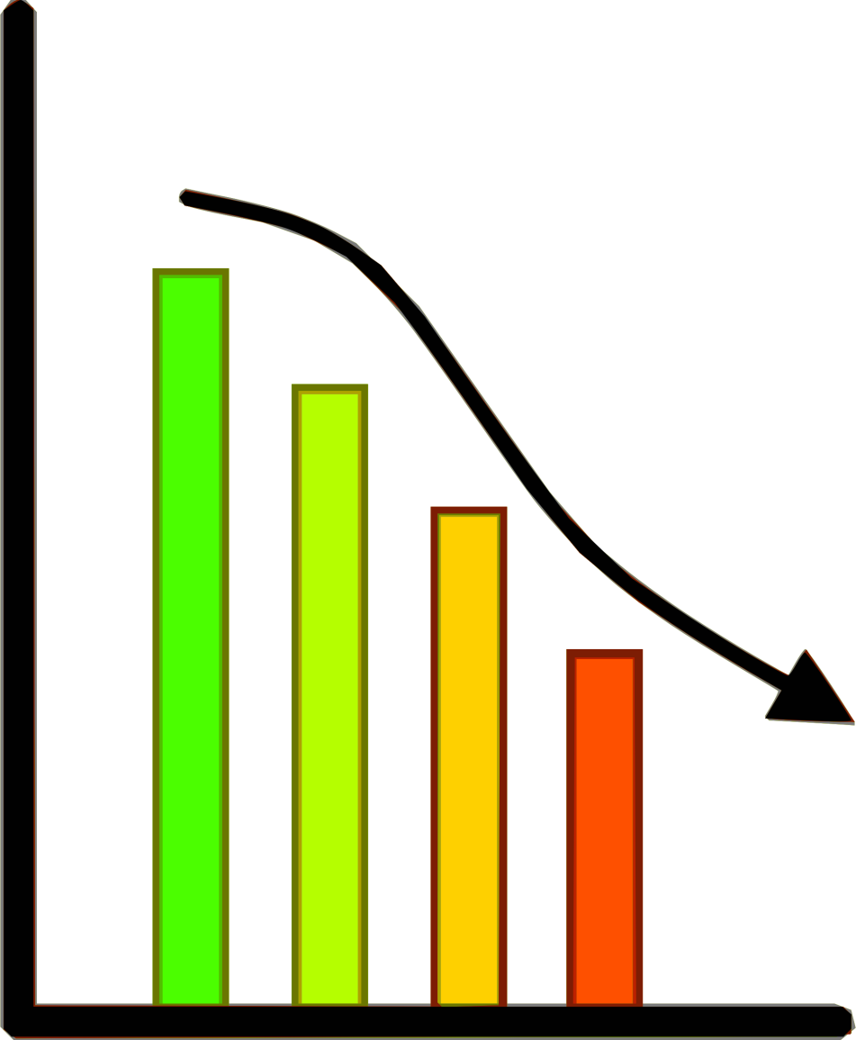
Why do we need graphs?

Slide 4
What makes a good graph?
Graphs should (Tufte, 2001):
Show the data.
Induce the reader to think about the data being presented (rather than some other aspect of the graph).
Avoid distorting the data.
Present many numbers with minimum ink.
Make large data sets (assuming you have one) coherent.
Encourage the reader to compare different pieces of data.
Reveal data.

Slide 5
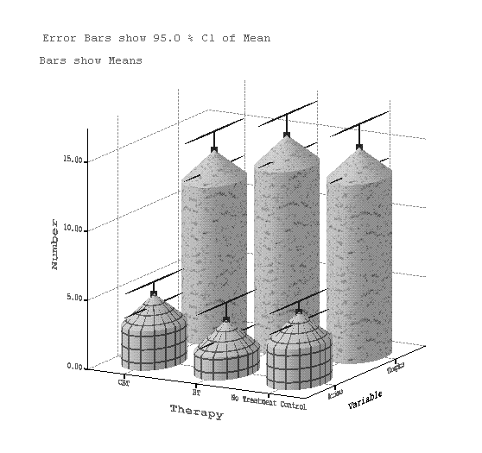
Why Is This Graph Bad?

Slide 6
Why Is This Graph Better?

Slide 7
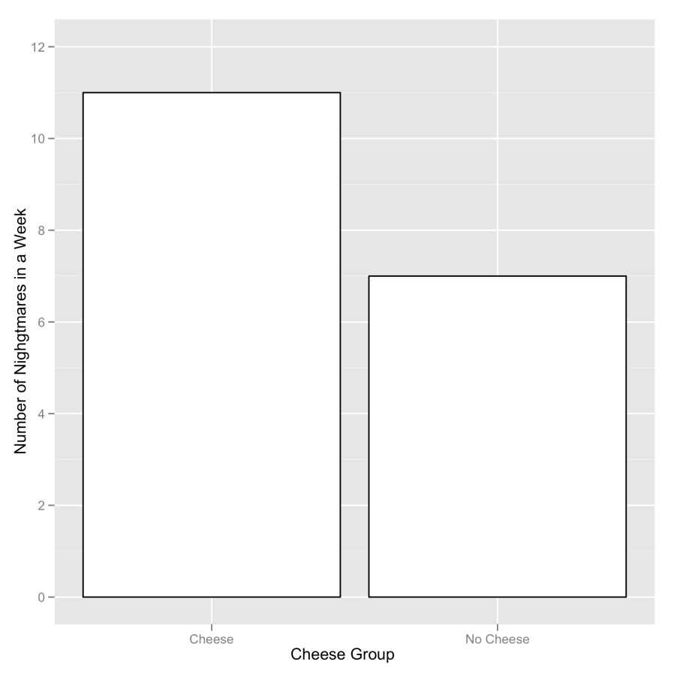
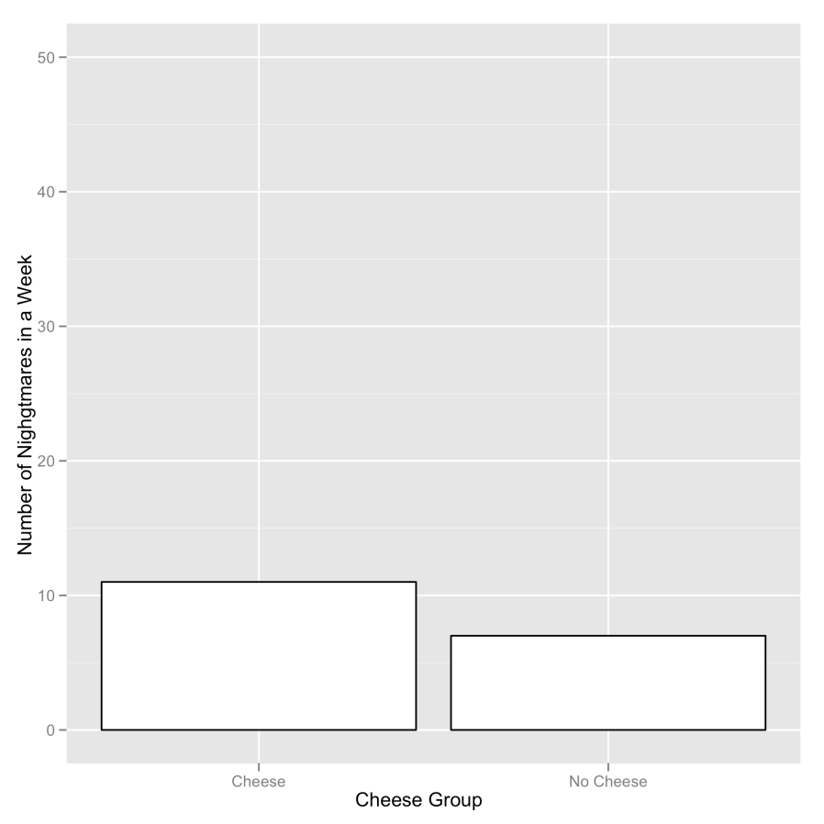
Deceiving the Reader
Two graphs about cheese

Slide 8
ggplot2
In ggplot2 a plot is made up of layers.

Slide 9
The anatomy of a graph

Slide 10
Geometric Objects
Creates a layer with bars representing different statistical properties
Data points
Connects data points with a straight line
A line that summarizes the data as a whole rather than connecting individual data points
Histogram
Box-whisker diagram
geom_bar()
geom_point()
geom_line()
geom_smooth()
geom_histogram()
geom_boxplot()

Slide 11
Specifying aesthetics in ggplot2

Slide 12
Scatterplots: Example
Anxiety and exam performance
Participants:
103 students
Measures
Time spent revising (hours)
Exam performance (%)
Exam Anxiety (the EAQ, score out of 100)
Gender

Slide 13
Simple Scatterplot
scatter <- ggplot(examData, aes(Anxiety, Exam))
scatter + geom_point() labs(x = "Exam Anxiety", y = "Exam Performance %")
scatter + geom_point() + geom_smooth() labs(x = "Exam Anxiety", y = "Exam Performance %")

Slide 14
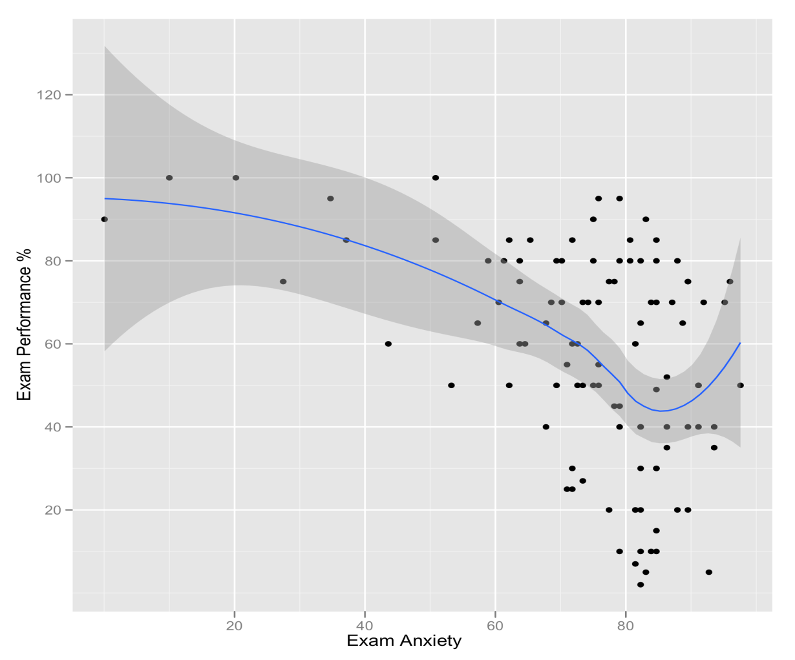
Simple Scatterplot
Scatterplot of exam anxiety against exam performance with a smoother added

Slide 15
Simple Scatterplot With Regression Line
scatter <- ggplot(examData, aes(Anxiety, Exam))
scatter + geom_point() + geom_smooth(method = "lm", colour = "Red")+ labs(x = "Exam Anxiety", y = "Exam Performance %")

Slide 16
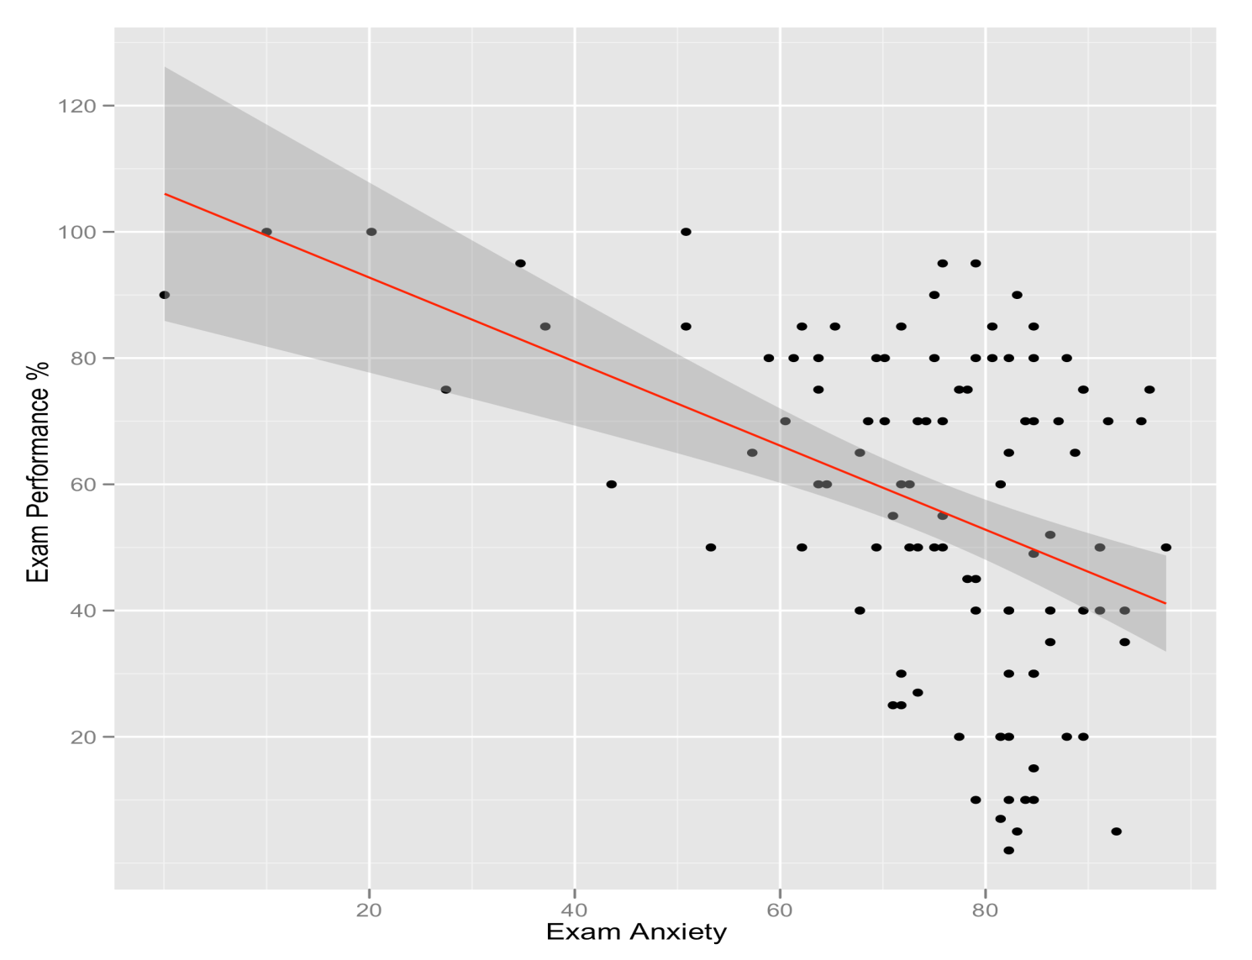
Simple Scatterplot
A simple scatterplot with a regression line added

Slide 17
Grouped Scatterplot
scatter <- ggplot(examData, aes(Anxiety, Exam, colour = Gender))
scatter + geom_point() + geom_smooth(method = "lm", aes(fill = Gender), alpha = 0.1) + labs(x = "Exam Anxiety", y = "Exam Performance %", colour = "Gender")

Slide 18
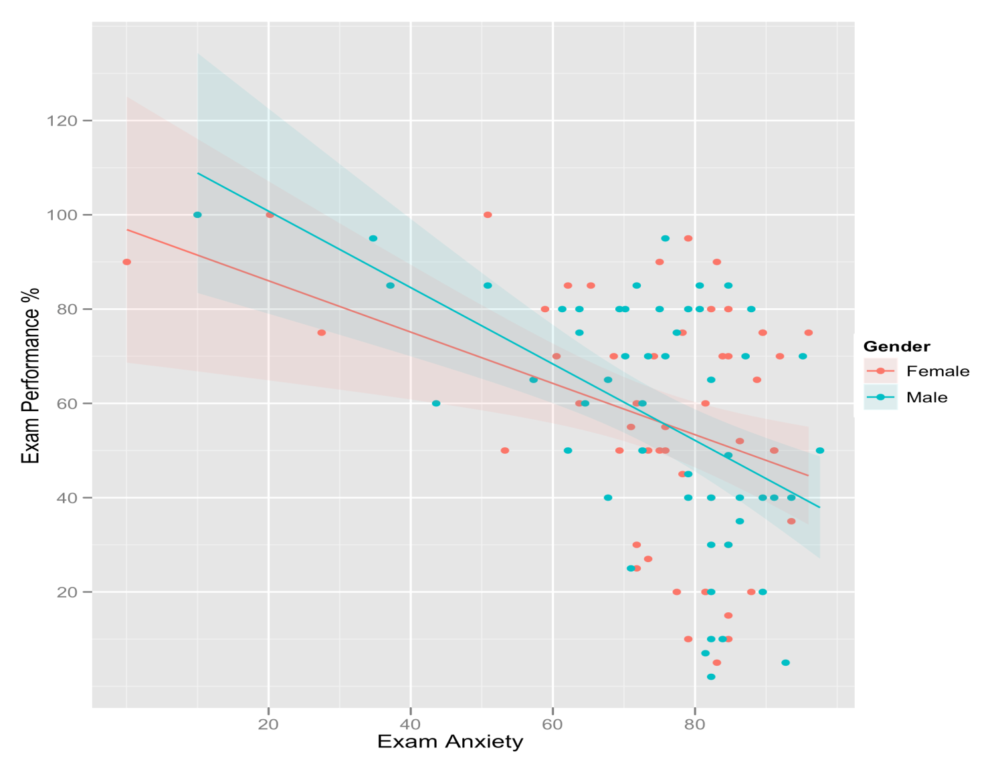
Grouped Scatterplot
Scatterplot of exam anxiety and exam performance split by gender

Slide 19
Histograms: Spotting Obvious Mistakes
Histograms plot:
The score/observations (x-axis)
The frequency (y-axis)
Histograms help us to identify:
The shape of the distribution
Skew
Kurtosis
Spread or variation in scores
Unusual scores

Slide 20
Histograms: Example
A biologist was worried about the potential health effects of music festivals.
Download Music Festival
Measured the hygiene of 810 concert-goers over the three days of the festival.
Hygiene was measured using a standardized technique :
Score ranged from 0 to 4
0 = you smell like a corpse rotting up a skunk’s arse
4 = you smell of sweet roses on a fresh spring day

Slide 21
Histogram of Hygiene Scores for Day 1
Create the plot object:
festivalHistogram <- ggplot(festivalData, aes(day1)) + opts(legend.position = "none")
Add the graphical layer:
festivalHistogram + geom_histogram(binwidth = 0.4 ) + labs(x = "Hygiene (Day 1 of Festival)", y = "Frequency")

Slide 22
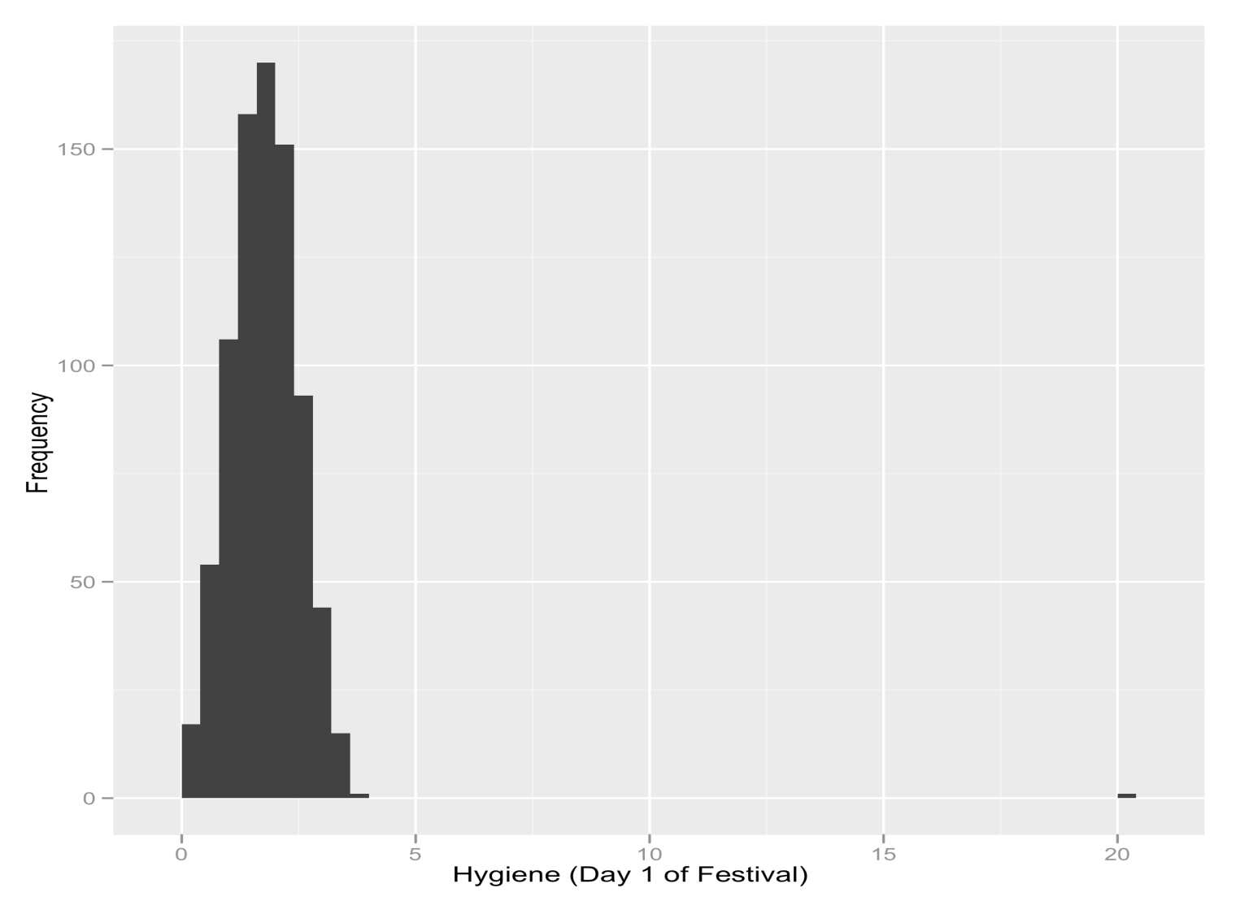
The Resulting Histogram

Slide 23
Boxplots (Box-Whisker Diagrams)
Boxplots are made up of a box and two whiskers.
The box shows:
The median
The upper and lower quartile
The limits within which the middle 50% of scores lie.
The whiskers show
The range of scores
The limits within which the top and bottom 25% of scores lie

Slide 24
What Does The Boxplot Show?

Slide 25
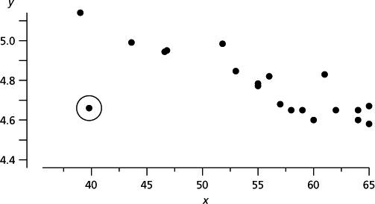
Outliers?
How do you find outliers?
What happens when we have outliers?

Slide 26
Error Bar Charts
The bar (usually) shows the mean score
The error bar sticks out from the bar like a whisker.
The error bar displays the precision of the mean in one of three ways:
The confidence interval (usually 95%)
The standard deviation
The standard error of the mean

Slide 27
Line Graphs: One Independent Variable
How to cure hiccups?
Participants:
15 hiccup sufferers
Each tries four interventions (in random order):
Baseline
Tongue-pulling manoeuvres
Massage of the carotid artery
Digital rectal massage
Outcome measure
The number of hiccups in the minute after each procedure

Slide 28
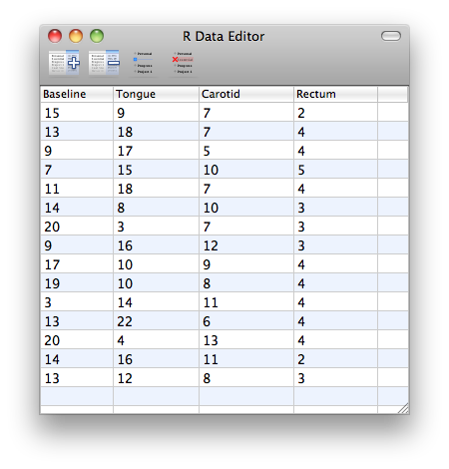

Slide 29
Line Graphs: One Independent Variable
These data are in the wrong format for ggplot2 to use.
We need all of the scores stacked up in a single column and then another variable that specifies the type of intervention.
We can rearrange the data as follows:
hiccups<-stack(hiccupsData)
names(hiccups)<-c("Hiccups","Intervention")

Slide 30
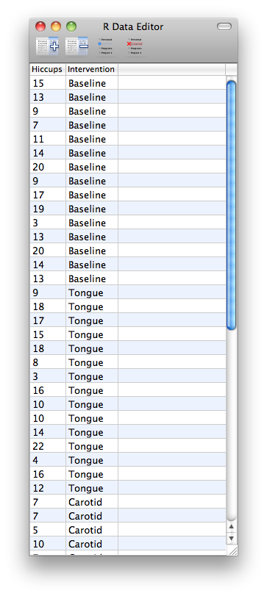

Slide 31
How to save your graph
You have now made the graph of your dreams, What now?
ggsave(filename)
Filename – should be a text string
.eps/.ps, .tex, .pdf, .jpeg, . Tiff, .png, . Bmp, . Svg, .wmf

